Slide 1
Ratings- Prediction Project

Slide 2
Exploratory Data Analysis

Slide 3
Steps
Collecting data using web scrapping and make my dataset.
Importing the libraries needed for my project
Loading the dataset/Creating my dataframe
Checking the head of the dataset(first five rows)
Checking the shape of the dataset
Checking the datatypes
Checking for null values if any
These data analysis steps help us to get an overview of our dataset and also help us in our preprocessing of our data.

Slide 4
Preprocessing of the data

Slide 5
Steps and Description
I have dropped the ‘Index’ column as it is of no use for the rating prediction.
Then I have converted the train data into lowercase as it is an NLP project.
Then I have removed punctuations ,stopwords to get a clean length.
Then I have converted text into vectors using TF-IDF so that the data gets ready for model building.
I have splitted the independent and dependant variables into x and y.

Slide 6
Observation
In my dataset ,there are two columns ,one is for ‘Reviews’ and other is for ‘Ratings’.
Ratings are given according to the reviews and it is observed that ratings are calculated out of 5,so there are 5 ratings in total.

Slide 7
Model building

Slide 8
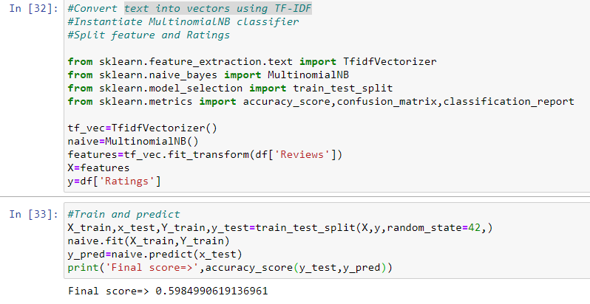
Explanation
I have used Multinomial Naïve Bayes classifier which is generally used for NLP project.
The accuracy score that is obtained is 60% which is not satisfactory.

Slide 9
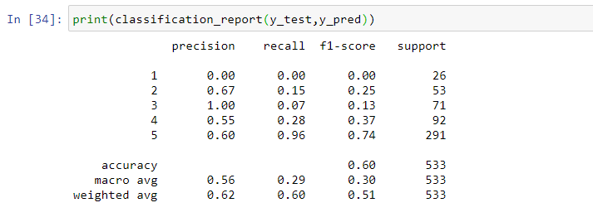
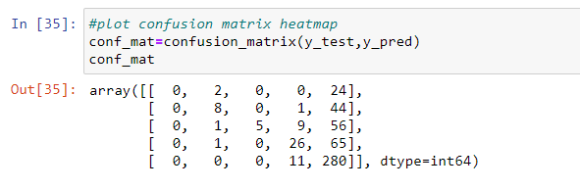
Metrics used :

